Slide 1
Global TRANSFORMATION ESTIMATION VIA LOCAL REGION CONSENSUS
Erez Farhan

Slide 2
The Challenge of Point Matching

Slide 3
The Challenge of Point Matching

Slide 4
The Challenge of Point Matching
Viewpoint/Pose
We focus on this
Illumination
Occlusions [self and incident]
Blur, sensor noise, etc.

Slide 5
A standard Solution – invariant local regions

Slide 6
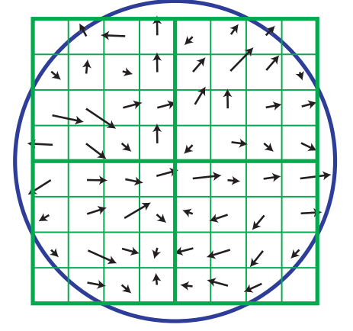
A Standard Solution – Invariant Local Regions
How to make invariant?
Normalize each region to canonic shape
Robust representation (description)
Robust matching methods
The good
Natural for point matching (local)
Good approximation (affine instead of perspective) – > normalization is possible
Underlying transformation estimation (Important for us!)
The bad
False matches
Normalization = estimation from few statistics
We are in a deadlock here!
Low resolution of matches

Slide 7
Breaking the deadlock
Anchor region
Neighbor candidate

Slide 8
Breaking the deadlock
Initialize with tentative matches from standard algorithm (MSER)
Find neighboring regions that agree on co-planarity
Unions of regions -> Effectively bigger regions
Gains
Better transformation precision
Beyond local approximation
Validating region matches
Bonus
Predict More point matches!
Question:
How to decide on merge?

Slide 9
Breaking the deadlock
Green – anchor region
Red – neighbor candidate

Slide 10
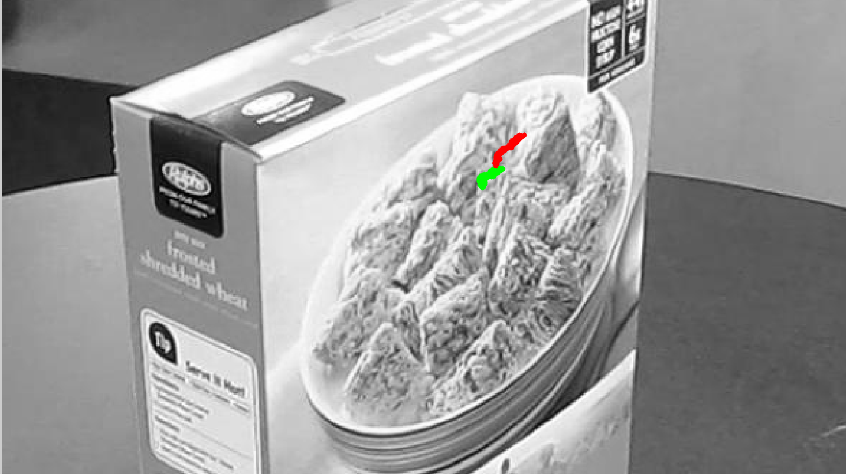
Consensus– predict target locations
Predicted neighbor
Original match

Slide 11
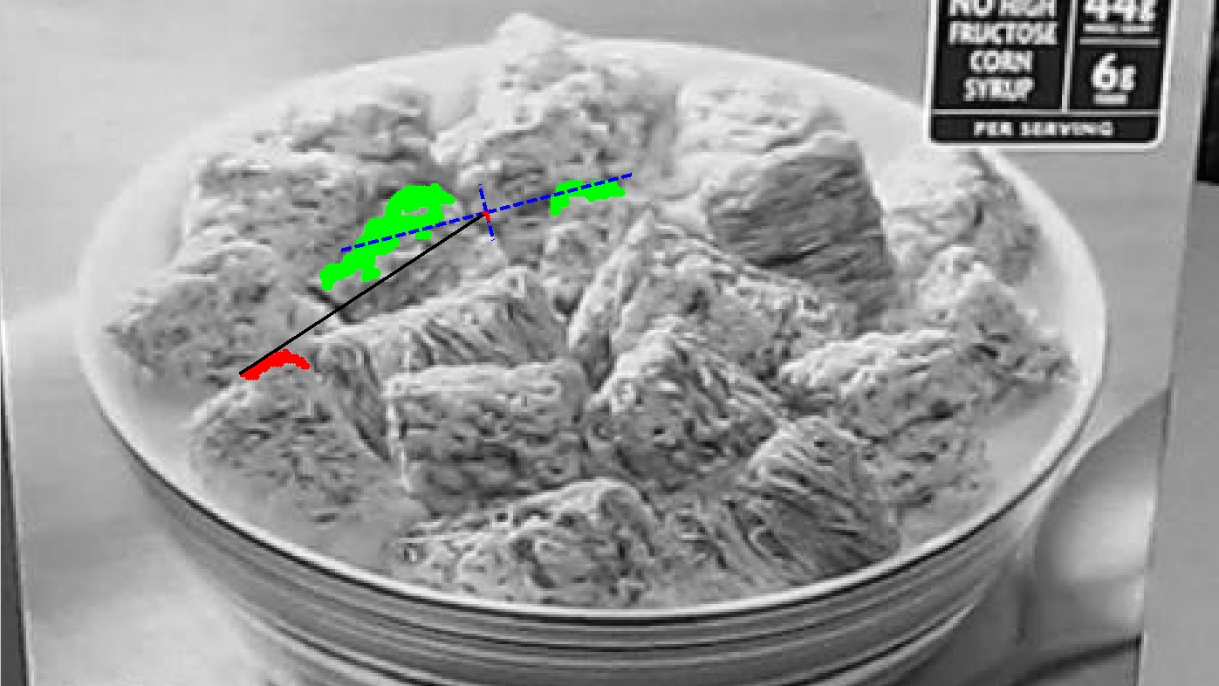
Consensus– Unite and eat another one!
New Unified Anchor
Next Neighbor

Slide 12
Improving Predictions
Predicted neighbor
Original match

Slide 13
Predicting New Points
Unified regions enables estimating planar perspective transform
Every point on the plane can now be predicted
Using the most appropriate group transform
Live example

Slide 14
Questions / Future Ideas?
Work with more complex transforms
(elastic)
Multiple

